Slide 1

Introduction to Public Health
PUBH01101
Public Health Institutions & Systems
Session 13
Logan University
College of Health Sciences
David Beavers, MEd, DC, MPH, FIACA

Slide 2
NOTE
PowerPoints and assigned readings are designed to complement each other and the textbook readings

Slide 3
Learning Objectives
Now that you have completed assignment 3, this powerPoint will cover in more detail the IOM reports about the public health care system
Identify goals of governmental public health
Identify the 10 essential services of public health
Describe basic features of local, state, and federal public health agencies in the United States
Identify global public health organizations and agencies and describe their basic roles

Slide 4
Learning Objectives
Identify roles in public health for federal agencies not identified as health agencies
Illustrate the need for collaboration by governmental public health agencies with other governmental and nongovernmental organizations
Describe approaches to connecting public health and the healthcare system

Slide 5
Vignette 1
A young man in your dormitory is diagnosed with tuberculosis. The health department works with the student health service to test everyone in the dorm, as well as in his classes, with a TB skin test. Those who are positive for the first time are advised to take a course of a medicine called INH.
Is this standard operating procedure?

Slide 6
Vignette 2
You go to a public health meeting and learn that many of the speakers are not from public health agencies, but from the Departments of Labor, Commerce, Housing, and Education.
What do these departments have to do with health?

Slide 7
Vignette 3
You hear that a new childhood vaccine was developed by the NIH, approved by the FDA, endorsed for federal payment by the CDC, and recommended for use by the American Academy of Pediatrics.
Do all these agencies and organizations always work so well together?

Slide 8
Vignette 4
A major flood in Asia leads to disease and starvation. Some say it is due to global warming, others to bad luck. Coordinated efforts by global health agencies, assisted by nongovernmental organizations (NGOs) and individual donors, help get the country back on its feet.
What types of cooperation are needed to make all of this happen?

Slide 9
Vignette 5
A local CHC identifies childhood obesity as a problem in the community. They collect data demonstrating that the problem begins as early as elementary school. They develop a plan that includes clinical interventions at the health center and also at the elementary school.
They ask the health department to help them organize an educational campaign and assist in evaluating the results. Working together, they are able to reduce the obesity rate among elementary school children by 50%. This seems like a new way to practice public health, you conclude. What type of approach is this?

Slide 10
Concepts to consider (1)
What are the goals and roles of governmental public health agencies?
What are the ten essential public health services?
What are the roles of local and state public health agencies?
What are the roles of federal public health agencies?
What are the roles of global health organizations and agencies?

Slide 11
Concepts to consider (2)
How can public health agencies work together?
What other government agencies are involved in health issues?
What roles do non-governmental organizations play in public health?
How can public health agencies partner with health care to improve the response to health problems?
How can public health take the lead in mobilizing community partnerships to identify and solve health problems?

Slide 12
Video about a Health system
All systems are similar, this is the Us Model
A health system
  the basis of improving health in any society or community
Watch video (8:01) about what is a health system: https://www.youtube.com/watch?v=LMHxxvbzFqc

Slide 13
Public Health in America statement goals
To prevent epidemics and the spread of disease
To protect against environmental hazards
To prevent injuries
To promote and encourage healthy behaviors
To respond to disasters and assist communities in recovery
To ensure the quality and accessibility of health services

Slide 14
Institute of medicine (iOM) public health services core functions for public health 1988
Assessment: obtaining data that defines the health of the population overall and specific groups within
Policy development: developing evidence based recommendations and other analyses of options to guide implementation
Assurance: oversight responsibility for ensuring key components of an effective health system

Slide 15
IOM public health services Ten Essential Public Health Services 1994
Assessment:
  Monitor health status to identify and solve community health problems
  Diagnose and investigate health problems and health hazards in the community

Slide 16
Ten Essential Public Health Services
Policy Development:
  Inform, educate, and empower people about health issues
  Mobilize community partnerships and action to identify and solve health problems
  Develop policies and plans that support individual and community health efforts

Slide 17
Ten Essential Public Health Services
Assurance:
  Enforce laws and regulations that protect health and ensure safety
  Link people to needed personal services and ensure the provision of health care when otherwise unavailable
  Ensure the provision of a competent public and personal health care workforce

Slide 18
Ten Essential Public Health Services
Assurance (cont’d)
  Evaluate effectiveness, accessibility, and quality of personal and population-based health services
All three IOM Core functions
  Research for new insights and innovative solutions to health problems

Slide 19
10 Essential Public Health Services with examples
Core Function: Assessment
  Monitor health status to identify and solve community health problems
    Ex. Health surveys and surveillance of reportable diseases
  Diagnose and investigate health problems and health hazards in the community
    Ex. Epidemic investigations and state public health laboratories

Slide 20
10 Essential Public Health Services with examples
Core Function: Policy Development
  Inform, educate, and empower people about health issues
    Ex. Comprehensive state tobacco programs
  Diagnose and investigate health problems and health hazards in the community
    Ex. Lead control programs
  Develop policies and plans that support individual and community health efforts
    Newborn screening for genetic diseases

Slide 21
10 Essential Public Health Services with examples
Core Function: Assurance
  Enforce laws and regulations that protect health and ensure safety
    Ex. FDA drug approvals
  Link people to needed personal health services and ensure the provision of health care when otherwise unavailable
    Ex. Community health centers

Slide 22
10 Essential Public Health Services with examples
Core Function: Assurance
  Ensure the provision of a competent public and personal healthcare workforce
    Ex. Licensure of health professionals
  Evaluate effectiveness, accessibility, and quality of personal and population-based health services
    Ex. Development of evidence-based recommendations

Slide 23
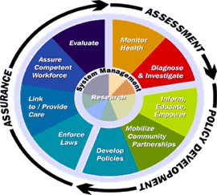
10 Essential Public Health Services with examples
Core Function: All three IOM core functions
  Research for new insights and innovative solutions to health problems
    Ex. NIH and other federal agencies
Data from Public Health in America. Essential Public Health Services. Available at http://www.health.gov/phfunctions/public.htm.

Slide 24
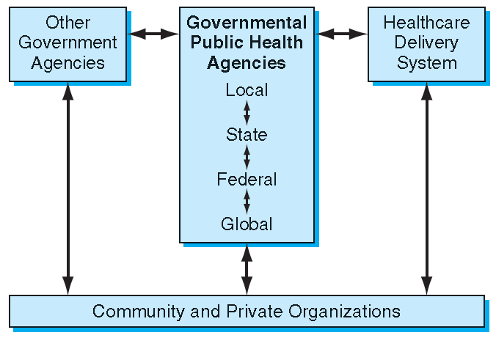
Framework for viewing governmental public health agencies and their complicated connections

Slide 25
Local Health Department Roles
Immunizations for those not covered by the private system
Communicable disease surveillance and initial investigation of outbreaks
Communicable disease control
Inspection and licensing of restaurants
Environmental health surveillance
Coordinating public health screening programs
Tobacco control programs
Public health preparedness and response to disasters

Slide 26
State Health Department Roles
Collecting vital statistics
Running a public health laboratory
Licensing health professionals
Administering nutrition program
Regulating health facilities
Drinking water regulation
Administration of the state Medicaid program
Office of the medical examiner

Slide 27
Federal Public Health Agencies Roles
The Department of Health and Human Services (DHHS) is the central public health agency of the federal government
  Responsible for the health of our nation
  Many sub-agencies
    See next slide

Slide 28
Key Federal Health Agencies of the DHHS
CDC
ATSDR
NIH
FDA
HRSA
AHRQ
SAMHSA
HIS
Web search (“google”) to see what these stand for if you do not know what initials are

Slide 29
Roles of Global Health Organizations and Agencies
Public health is increasingly becoming a global enterprise and global governmental efforts have grown dramatically in recent years
  See next slide for structure and governance

Slide 30
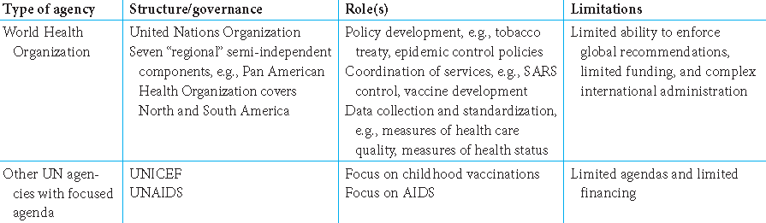
Global Public Health Organizations

Slide 31
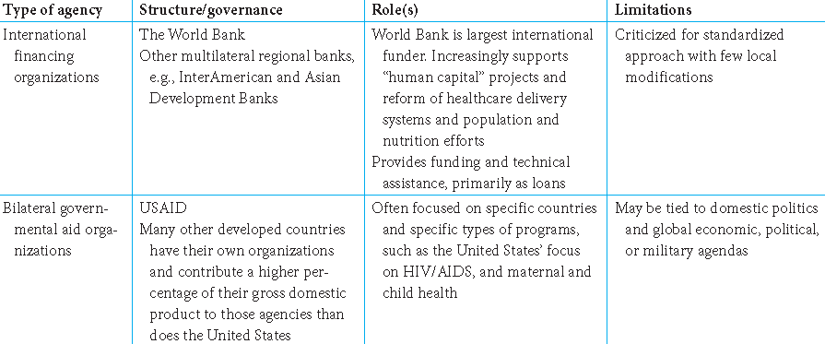
Global Public Health Organizations

Slide 32
How Public Health Agencies
Work Together
Collaboration needs to be an everyday effort
  Not just a requirement for emergencies or epidemics
Must coordinate local, state, federal and global public health agencies into one unified effort
  As evidenced by the public health response to SARS by the WHO, CDC, national agencies and local agencies

Slide 33
What Other Government Agencies Are Involved in Health Issues?
Environmental Protection Agency (EPA)
  Examines environmental health issues and makes recommendations
Occupational Safety and Health Administration (OSHA)
  Aims to reduce injuries and hazardous exposures
  in the workplace
Department of Homeland Security
  Preparation and response to disasters and terrorism

Slide 34
What Other Government Agencies
Are Involved in Health Issues?
Department of Agriculture & the FDA
  Protects the nation’s food supply
Department of Housing and Urban Development
  Influences the built environment and its impacts on health
Department of Energy
  Sets radiation safety standards for nuclear power plants and other sources of energy

Slide 35
What Roles Do Non-Governmental Organizations Play in Public Health?
The American Red Cross
  Collects blood donations
  Obtains donations, mobilizes volunteers, and publicizes the need for disaster assistance
Doctors without Borders, Chiropractors without Borders & Physicians for Social Responsibility
  Physician groups that advocate, seek funding, and address ethical implementation of programs

Slide 36
What Roles Do Non-Governmental Organizations Play in Public Health?
Advocacy groups
  Advocate for public health interventions and aim to influence policy decisions
Private Organizations such as the American Cancer Society, The American Heart Association and the March of Dimes
  Provide public health education, support research, develop evidence-based recommendations, and other services

Slide 37
What Roles Do Non-Governmental Organizations Play in Public Health?
CARE & Oxfam International
  Provide services and advocate for global health-related crises
Private foundations such as the Gates Foundation & Robert Wood Johnson Foundation
  Fund public health efforts and stimulate government funding

Slide 38
How Can Public Health Agencies Partner with Health Care to Improve the Response to Health Problems?
Clinicians and public health professionals share a common commitment to:
  Evidence-based thinking
  Cost-effective delivery of services
  Providing quality services to the entire population and eliminating health disparities
  Computerized and confidential data systems

Slide 39
How Can Public Health Agencies Partner with Health Care to Improve the Response to Health Problems?
Community-oriented primary care (COPC) model
  Expand the delivery of health services from a focus on the individual to also include an additional focus on the needs of communities
  To connect the common commitments of public health and medicine

Slide 40
The Six Sequential Steps of COPC
Community definition
  How is the community defined based on common characteristics, i.e. geography?
Community characterization
  What are the demographics and health issues?
Prioritization
  What are the most important health issues? How can they be prioritized based on objective data and perceived need?

Slide 41
The Six Sequential Steps of COPC
Detailed assessment of the selected health problem
  What are the most effective interventions for addressing the problem?
Intervention
  What strategies will be used to implement the intervention?
Evaluation
  How can the success be measured?

Slide 42
Community-Based Participatory Research
Community members are involved in all phases of the research process, contributing their expertise while sharing ownership and responsibility
Assist in the building of trust, knowledge, and skills to facilitate the development and implementation of interventions

Slide 43
Community-oriented Public Health (COPH)
Coordinated mobilization of public and private efforts
Healthcare efforts are expanded to take on additional public health roles
Public health efforts are expanded to collaborate with healthcare delivery institutions, as well as other community and governmental efforts

Slide 44
end
If you have any questions,
contact me via Canvas e-mail

